Slide 1
Canteen Food Ordering &
Billing Management System
Design and Implementation of a Relational Database Management System
for a College Canteen
Kasani Hansith Raj
Roll No: 25WU0102117
Woxsen University | B.Tech AI/ML | August 2026

Slide 2
Agenda
What this review covers
01
Problem Identification
Why a database-driven canteen system is needed
02
Scope & Objectives
Boundaries and goals of the project
03
Users & Functional Requirements
Who uses the system and what it must do
04
Conceptual Design — ER Diagram
Entities, attributes and relationships
05
Initial Relational Schema
Proposed tables, keys and relationships
Canteen Food Ordering & Billing Management System | Review 1
2

Slide 3
Problem Identification
The Current Situation
Consequences
Canteen operations today rely on manual, disconnected methods to manage menus, take orders, track kitchen preparation and generate bills.
Menu items, prices, ingredients and stock levels are not maintained in a single organized system.
There is no unified record linking a placed order to the ingredients it consumes or the bill it generates.
Delayed service during rush hours due to the lack of a fast, centralized order-processing system.
Errors and mismatches between the orders taken and the bills generated.
Poor visibility into ingredient stock, leading to shortages or unnoticed wastage.
No consolidated sales history, so popular items, revenue trends and daily performance cannot be reviewed.
Canteen Food Ordering & Billing Management System | Review 1
3

Slide 4
Scope & Objectives
Scope
Covers menu & category management, ordering, kitchen status tracking, billing, payments and ingredient stock usage.
Built as a normalized relational database (up to 3NF) with a Python front-end application.
Limited to a single canteen outlet — multi-branch operation is out of scope.
Objectives
1. Design a normalized ER model and relational schema for canteen operations.
2. Enforce data integrity with primary keys, foreign keys and business-rule constraints.
3. Enable fast order entry, kitchen tracking and billing through a simple application.
4. Generate reports: daily sales, popular items, pending orders, ingredient consumption and revenue.
Canteen Food Ordering & Billing Management System | Review 1
4

Slide 5
System Users
Who interacts with the system, and how
Customer
Canteen Staff / Cashier
Students / Staff / Guests
Order & billing desk
Browse the menu, place orders and make payments.
Take orders, generate bills, record payments.
Kitchen Staff
Canteen Manager
Food preparation
Administration
View pending orders, update kitchen task status, use ingredient stock.
Maintain the menu, monitor stock and view sales reports.
Canteen Food Ordering & Billing Management System | Review 1
5

Slide 6
Functional Requirements
1
Maintain menu categories and food items, including price and availability.
2
Allow a customer / cashier to place an order with one or more food items.
Reject orders for items that are marked unavailable.
4
Track each order through statuses: Placed → Preparing → Ready → Served (or Cancelled).
5
Generate a bill for a completed order with discount and tax, and record payment.
Deduct ingredient stock automatically based on the recipe of items ordered.
Produce reports: daily sales, popular items, category-wise sales, pending orders, ingredient consumption and revenue.
Canteen Food Ordering & Billing Management System | Review 1
6

Slide 7
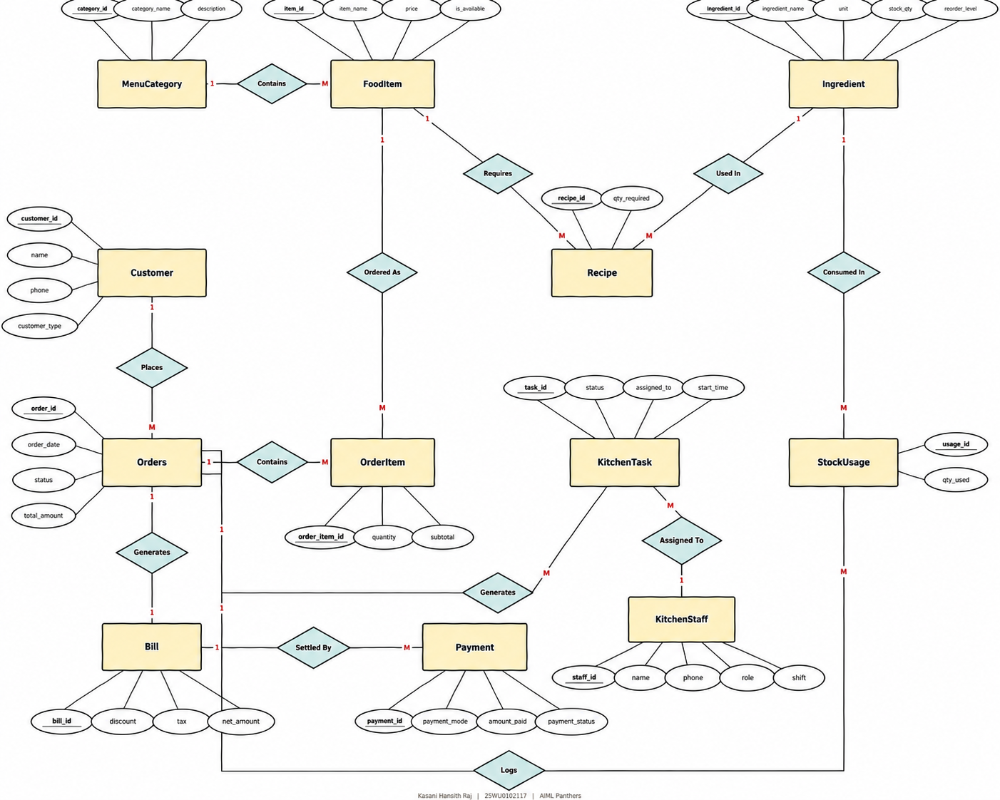
Canteen Food Ordering & Billing Management System | Review 1
7

Slide 8
ER Diagram — Relationship Notes
MenuCategory — FoodItem
1 : M
A category groups many food items.
FoodItem — Recipe — Ingredient
M : M
A food item needs many ingredients; an ingredient is used in many items.
Customer — Orders
1 : M
A customer can place many orders.
Orders — OrderItem — FoodItem
1 : M / M : 1
An order contains many order-items, each pointing to one food item.
Orders — KitchenTask
1 : M
An order generates one or more kitchen preparation tasks.
Orders — Bill
1 : 1
Each completed order produces exactly one bill.
Bill — Payment
1 : M
A bill can be settled through one or more payments.
Ingredient — StockUsage — Orders
1 : M
Serving an order consumes (uses) ingredient stock, logged per order.
Canteen Food Ordering & Billing Management System | Review 1
8

Slide 9
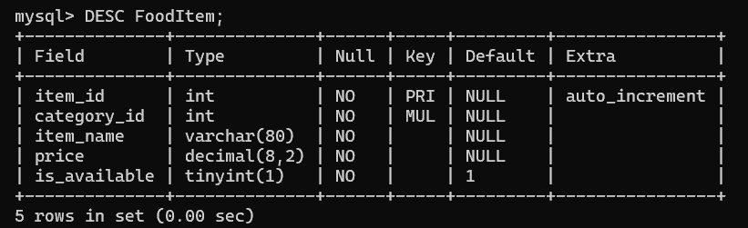
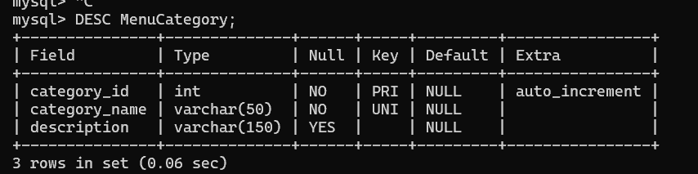
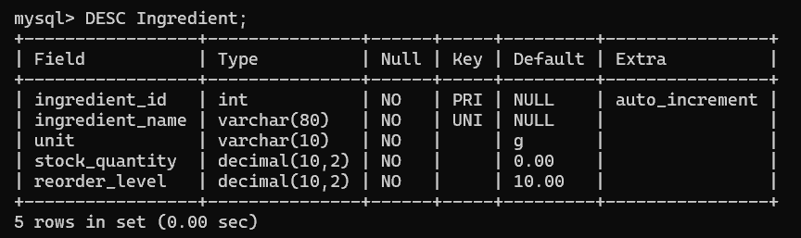
Relational Schema — MySQL DESC Output
MenuCategory
FoodItem
Ingredient
Canteen Food Ordering & Billing Management System | Review 1
9

Slide 10
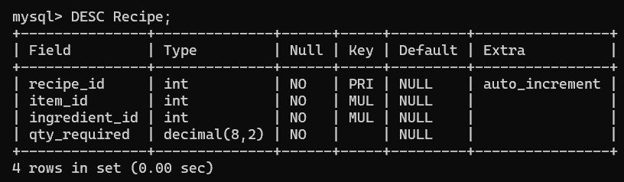
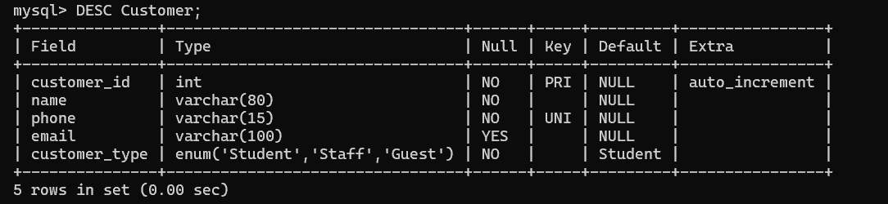
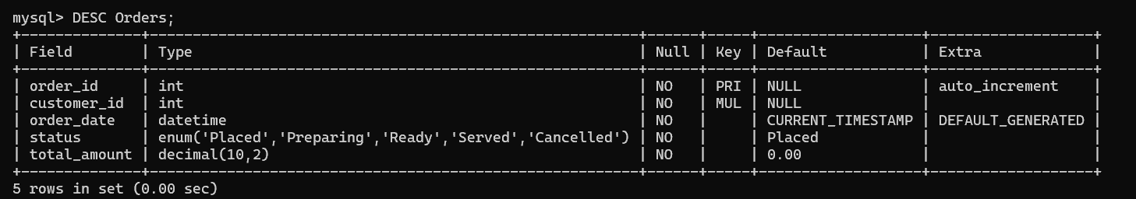
Recipe
Customer
Orders
Canteen Food Ordering & Billing Management System | Review 1
10

Slide 11
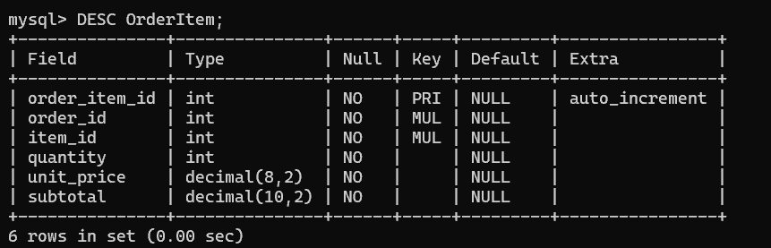
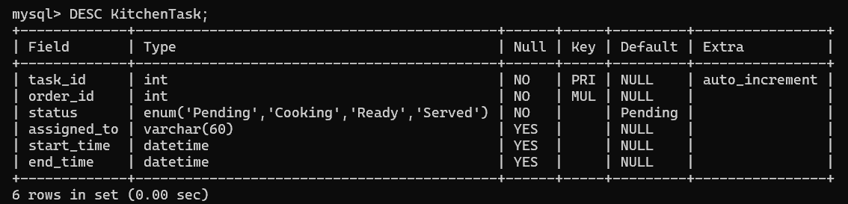
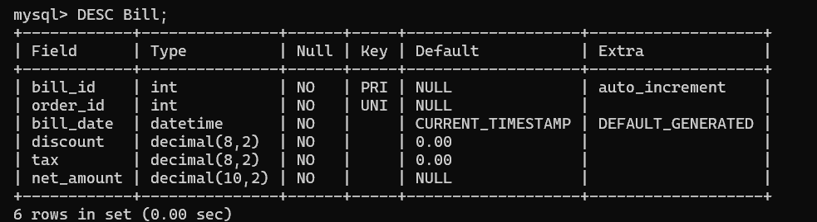
OrderItem
KitchenTask
Bill
Canteen Food Ordering & Billing Management System | Review 1
11

Slide 12
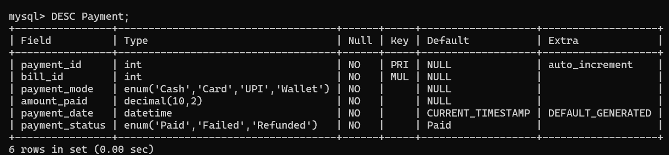
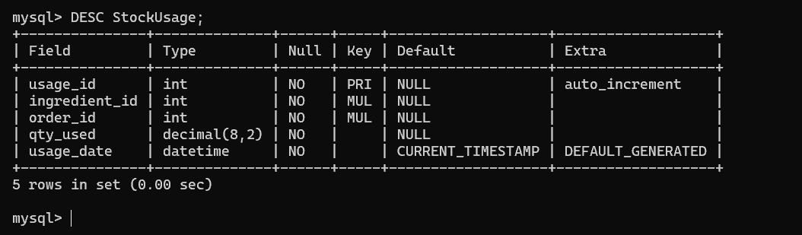
Payment
StockUsage
Canteen Food Ordering & Billing Management System | Review 1
12

Slide 13
Thank You
Kasani Hansith Raj | 25WU0102117 | AIML Panthers

